Slide 1

Data Analytics Internship Portfolio
End-to-End Analytics Journey
N REDDI HARI SANKAR
Transforming Raw Data into Actionable Business Insights

Slide 2
About Me
1
Data Analytics
2
Business Intelligence
3
Data Visualization
4
Statistical Analysis
5
Data Storytelling
Aspiring Data Analyst with hands-on experience across the full analytics lifecycle — from raw data to business recommendations.

Slide 3

Internship Journey at a Glance
Four projects covering the complete analytics workflow — from raw data to business decisions.
Raw Data → Cleaning → Analysis → Dashboarding → Statistical Validation → Business Recommendations
Data Wrangling
1
EDA & BI
2
Dashboarding
3
Statistical Validation
4

Slide 4
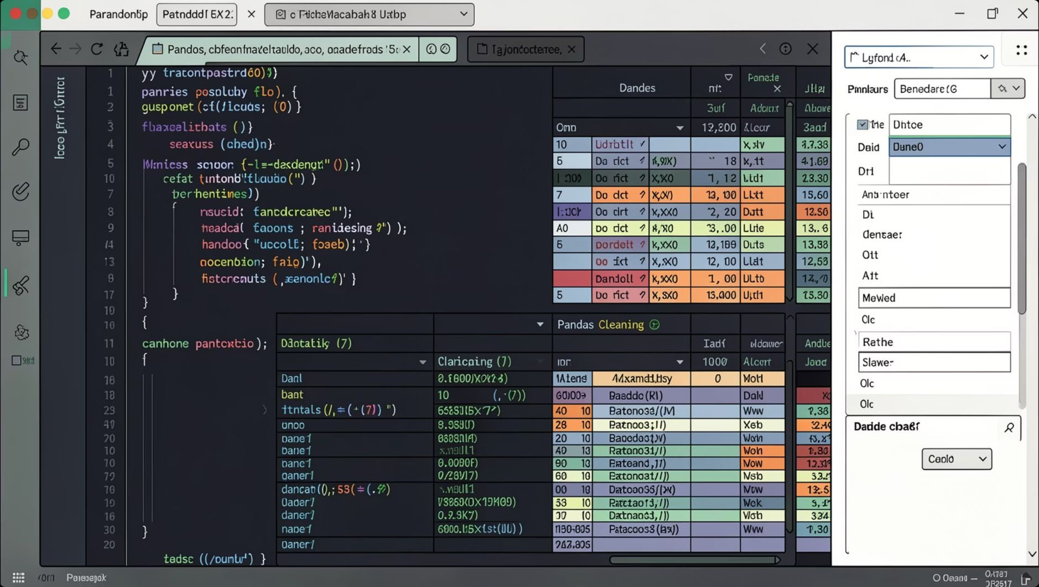
TASK 1
Data Immersion & Wrangling
Objective
Techniques Applied
Tools
Prepare raw project management data for analysis.
Missing value handling & duplicate removal
Date standardization & feature engineering
Task Status, Duration & Progress % fields
Python · Pandas · NumPy · Google Colab · GitHub

Slide 5
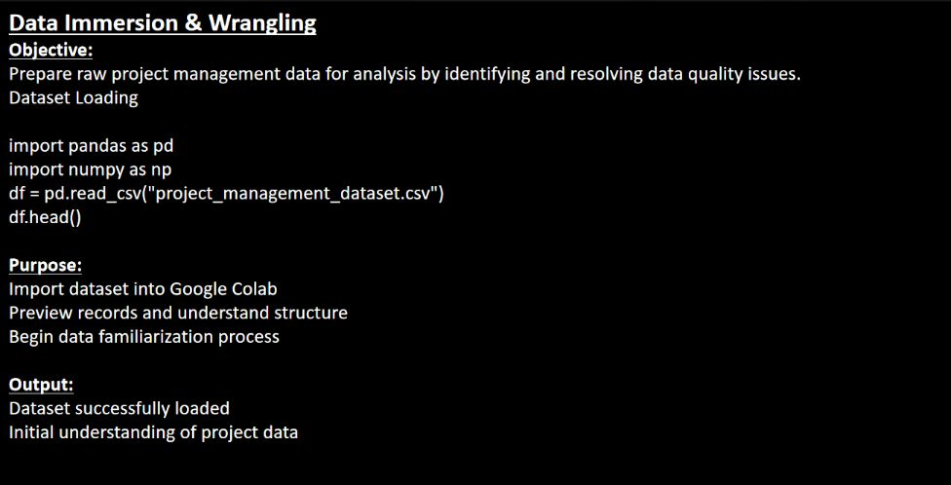

Slide 6
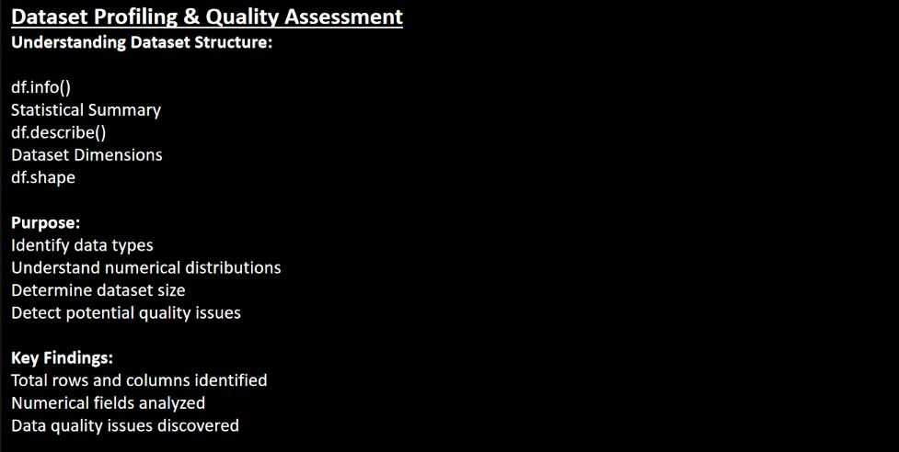

Slide 7
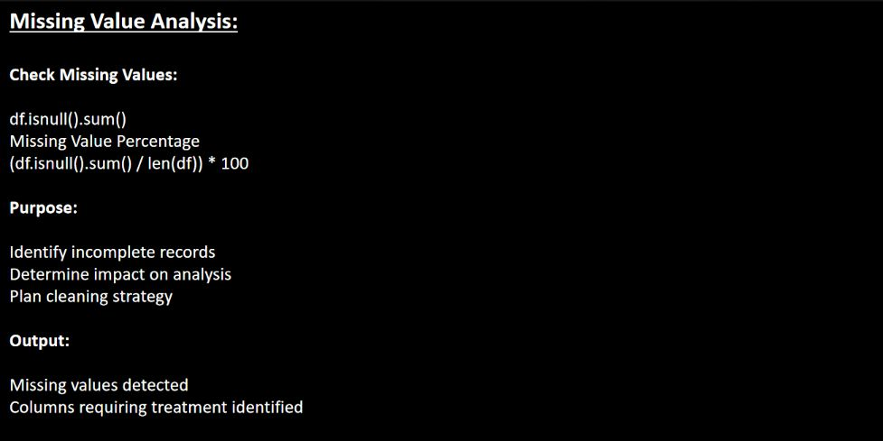

Slide 8
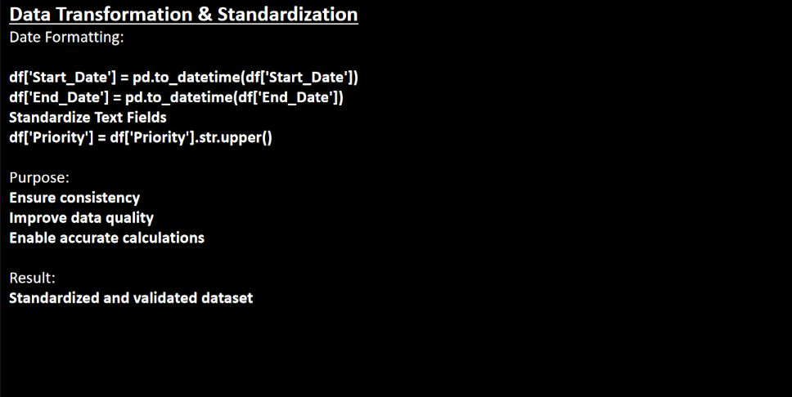

Slide 9
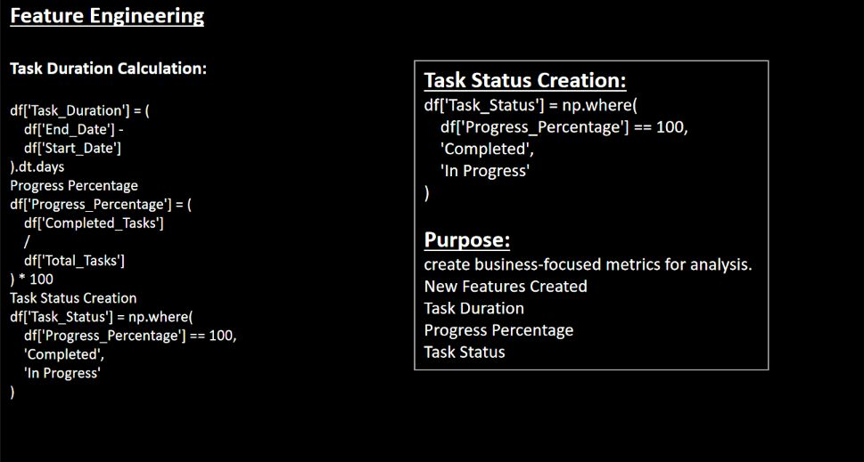

Slide 10

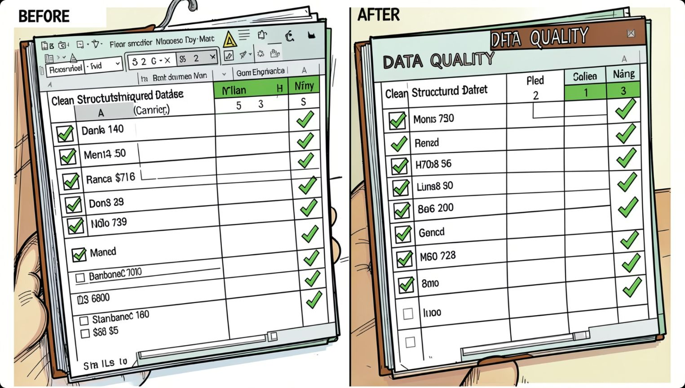
TASK 1 — RESULTS
Clean Data, Reliable Insights
Key Learning: Insight quality depends on data quality.
Outcomes
Clean, structured, analysis-ready dataset
Reduced redundancy, improved consistency
Foundation for accurate reporting & forecasting

Slide 11
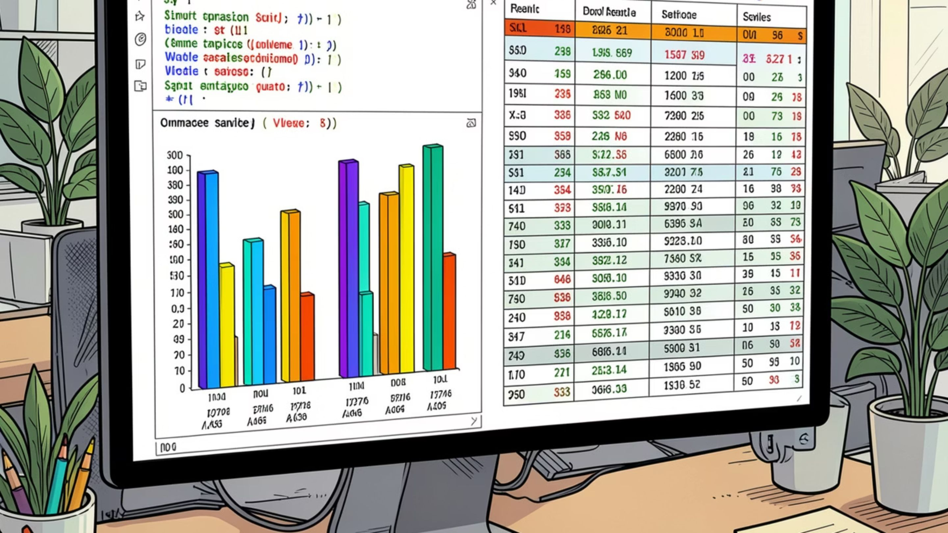
TASK 2
Exploratory Data Analysis & Business Intelligence
Analyzed employee data using SQL and Python to answer key business questions.
Salary Analysis
Highest, lowest, average salaries; threshold filtering
Department Insights
Workforce distribution and salary spend by department
Employee Ranking
Ranked employees by salary metrics for compensation review

Slide 12
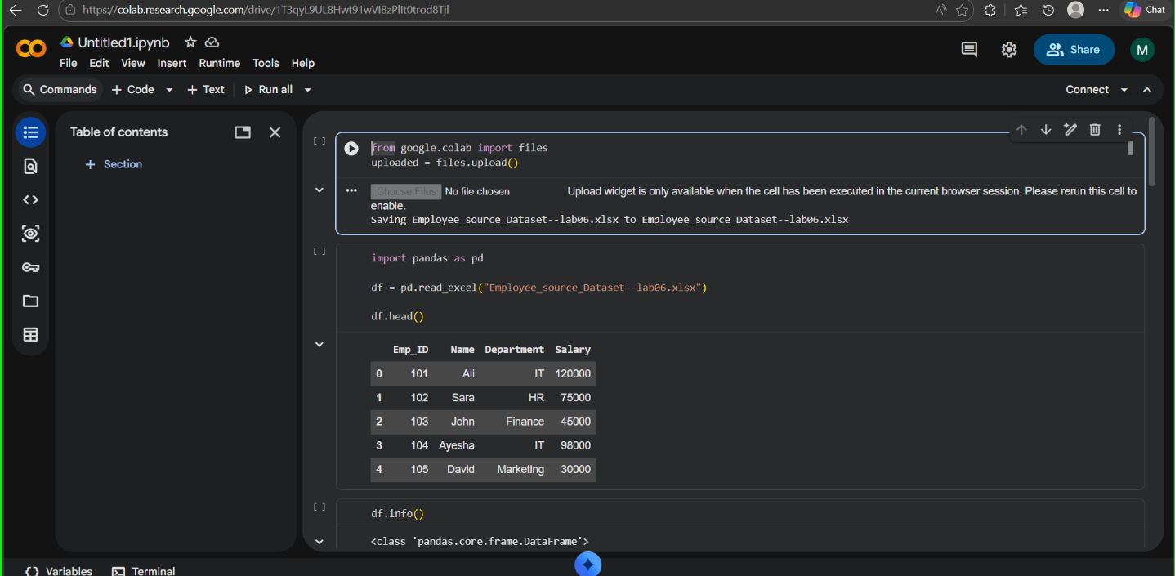

Slide 13
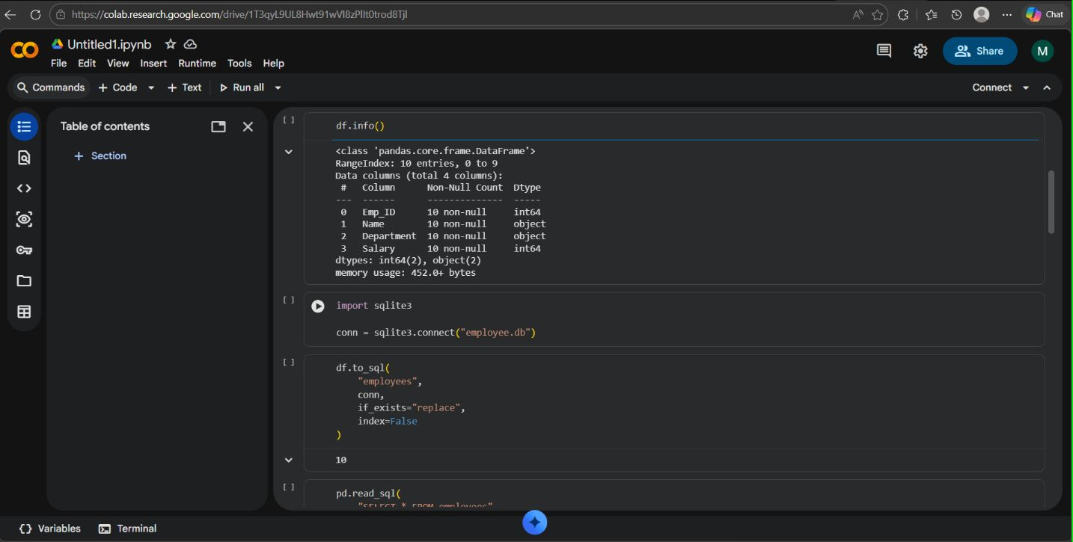

Slide 14
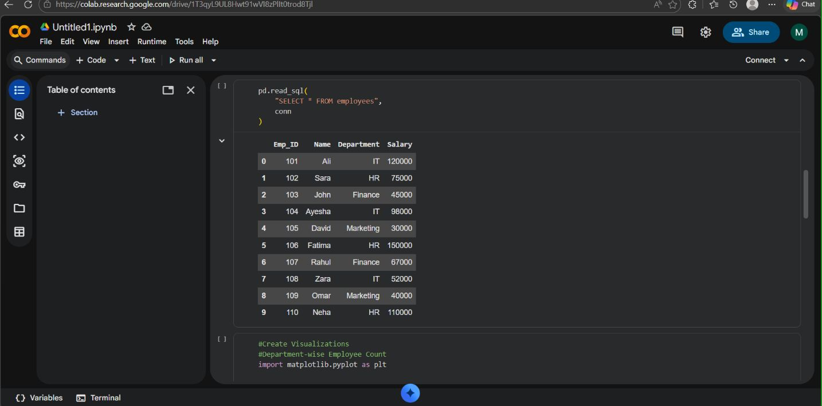

Slide 15
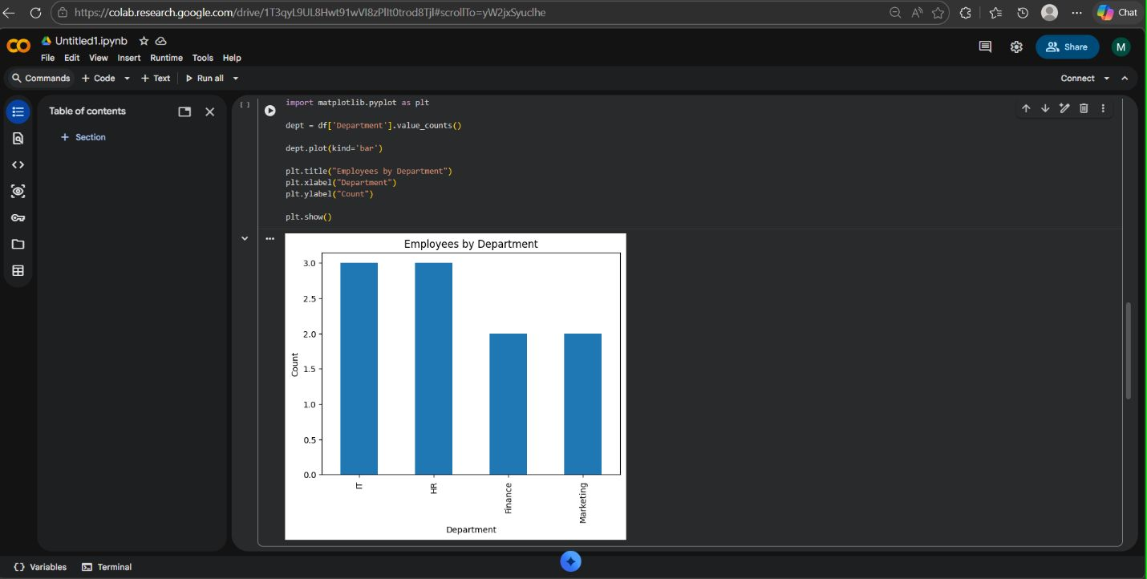

Slide 16
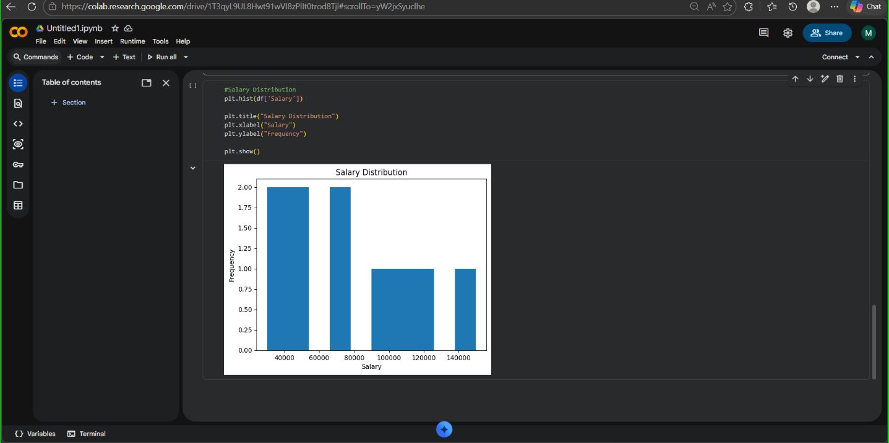

Slide 17
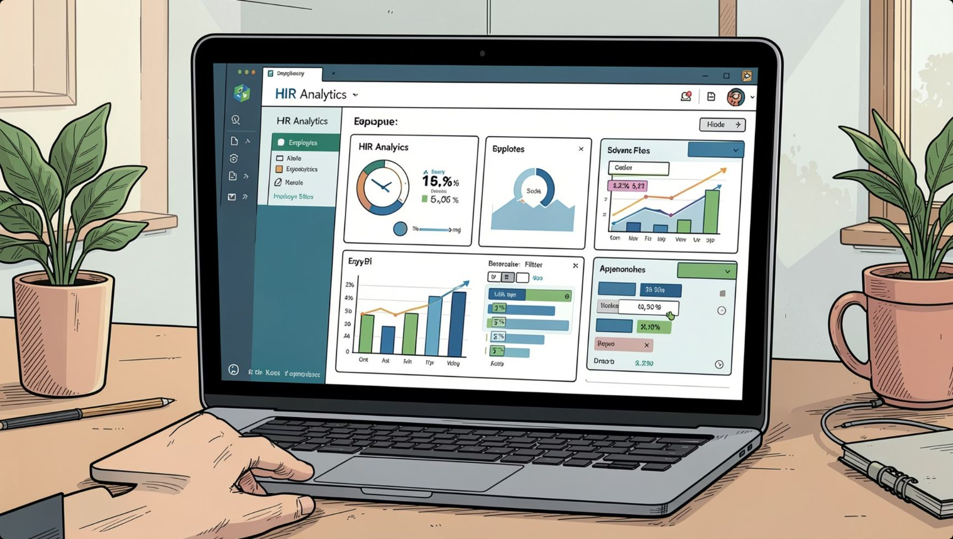
TASK 3
Interactive HR Analytics Dashboard
Dashboard Components
Business Value
Tools
KPIs: Total Employees, Salary Cost, Avg/Max/Min Salary
Employee & salary distribution charts
Interactive filters by department
Real-time workforce monitoring, faster decisions, improved reporting efficiency.
Power BI · DAX · Excel

Slide 18
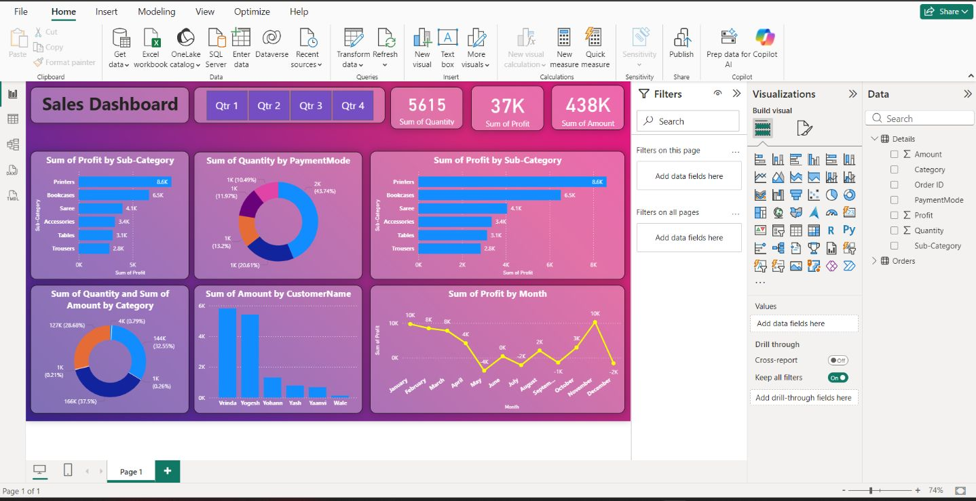

Slide 19

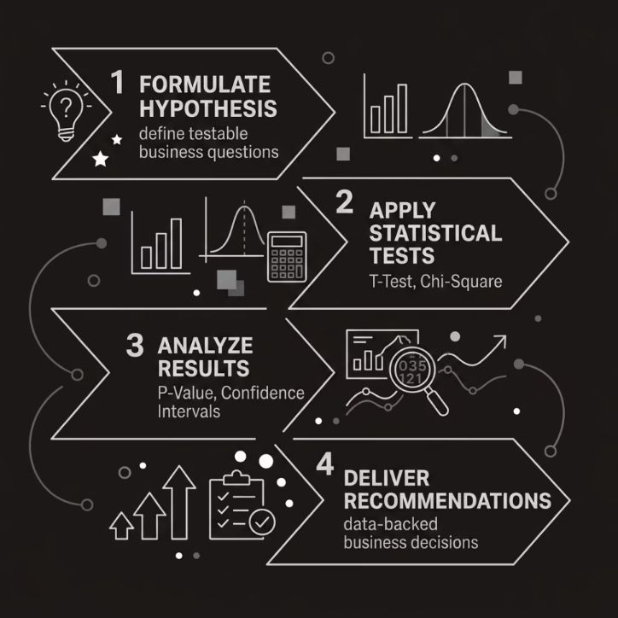
TASK 4
Business Narrative & Statistical Validation
Objective
Convert findings into a compelling, statistically validated business story.
Methods Used
T-Test & Chi-Square Test
P-Value analysis & confidence intervals
Data-backed recommendations
Impact
Statistical evidence ensures conclusions are reliable — not coincidental.

Slide 20

Skills Acquired
5
5
5
Python
SQL
Power BI
Pandas · NumPy
SQLite · Queries
DAX · Dashboards
5
5
Statistics
Data Storytelling
T-Test · Hypothesis
EDA · Visualization

Slide 21

Key Learnings & Conclusion
Data becomes valuable when transformed into meaningful insights that drive better decisions.
Thank You — Kovvuri Gnana Swarupa
Data Quality First
Clean data drives reliable insights
End-to-End Workflow
Wrangling → EDA → Dashboards → Validation
Business Communication
Translate analysis into clear recommendations

